Slide 1
Project Based Learning - III
SUBMITED TO :- MR. ATESH SINGH SIR
SUBMITED BY:- PRIYANSHU VERMA 142
SANCHIT CHORGHADE 172

Slide 2
Problem statement taken by SIH-1666
Description :- A lack of adequate career counselling and guidance in schools contributes to poor career choices among students, leading to mismatched skills, job dissatisfaction, and unemployment. In India, many students and their families are unaware of the diverse career opportunities available, often leading to choices based on limited information or societal pressure. Effective career counselling and guidance are essential for helping students make informed decisions about their futures and aligning their education with their career aspirations. The National Education Policy (NEP) 2020 emphasizes the need for holistic education, which includes providing students with the guidance necessary to make informed career choices. Description: The proposed solution focuses on implementing comprehensive career counselling and guidance programs in schools. This includes training career counsellors, developing resources and tools for career exploration, and integrating career guidance into the school curriculum. Programs should provide personalized counselling sessions, workshops, and access to information on various career paths and educational requirements. Additionally, leveraging technology to create interactive platforms for career exploration can enhance student engagement and awareness. These initiatives align with NEP 2020's vision of equipping students with the knowledge and skills to pursue their career aspirations. Innovative Solutions: a) AI-Powered Career Guidance Platforms: Develop AI-driven platforms that provide personalized career advice based on students' interests, strengths, and market trends. b) Career Mentorship Programs: Establish mentorship programs where students can receive guidance and support from professionals in their fields of interest. c) Interactive Career Exploration Tools: Create digital tools and apps that allow students to explore different careers through virtual simulations, videos, and interactive content. d) Comprehensive Career Resource Portals: Develop online portals with extensive resources on career options, required skills, educational pathways, and job market trends. By implementing these innovative solutions, we aim to improve career counselling and guidance in schools, helping students make informed career choices that align with their interests and the demands of the job market. This approach supports NEP 2020's goal of providing holistic and relevant education to all students.

Slide 3

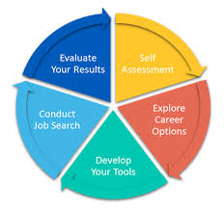
Problem statement found by SIH:- SIH1666
Introduction to Career Guidance Management System
Welcome to this presentation on career guidance management systems. This system is designed to help students after 10th and 12th grade make informed decisions about their future education and career paths.

Slide 4

Importance of Career Guidance after 10th and 12th
1
Informed Choices
2
Reduces Uncertainty
Provides students with the knowledge and resources to make informed decisions about their future.
Helps alleviate anxieties and doubts by providing clarity about their options.
3
Increased Success Rate
4
Development of Soft Skills
Improves the chances of achieving career goals and finding fulfilling employment.
Empowers students to develop essential skills, such as self-awareness, critical thinking, and decision-making.

Slide 5
Assessing Individual Strengths and Interests
Skill Assessment
Interest Exploration
Values and Goals
Identifies the skills and abilities students possess, through assessments and aptitude tests.
Helps students discover their passions, interests, and what they enjoy doing.
Explores students' personal values, aspirations, and long-term goals.

Slide 6
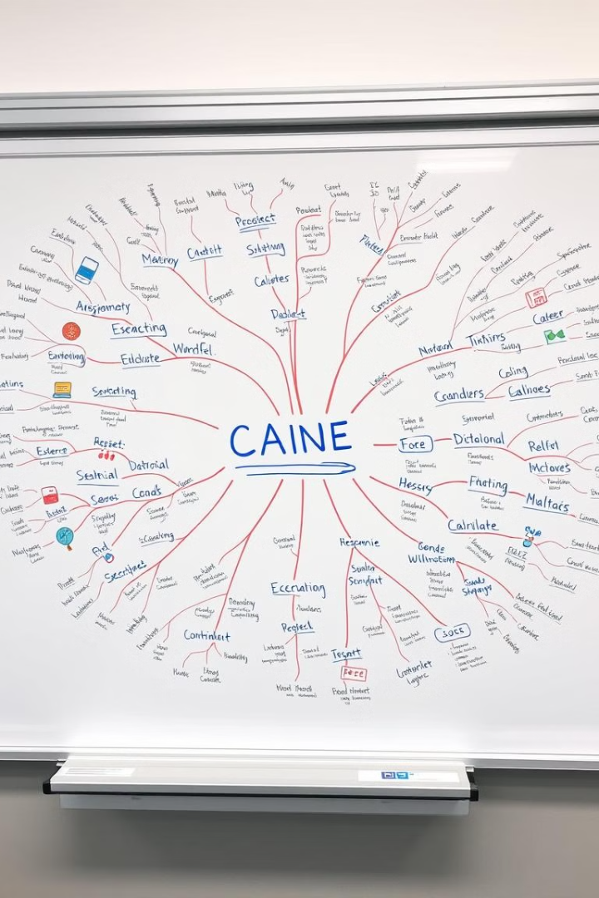
Exploring Educational and Career Pathways
1
Educational Options
Provides information about various educational options, such as colleges, universities, vocational schools, and apprenticeships.
2
Career Fields
Presents a wide range of career fields, describing the roles, responsibilities, and required skills for each profession.
3
Industry Trends
Keeps students updated on emerging trends, job market demands, and future prospects for different careers.

Slide 7




Personalized Counseling and Mentorship
Individualized Guidance
Provides one-on-one counseling to address specific concerns, questions, and needs.
Mentorship Programs
Connects students with industry professionals who serve as role models and provide guidance.
Skill Development
Offers resources and support for developing skills relevant to their chosen career paths.

Slide 8

Connecting with Industry Professionals
Networking Events
Industry Visits
Organizes workshops, conferences, and career fairs where students can interact with professionals from various industries.
Arranges visits to companies and organizations to gain firsthand insights into different work environments.
Internships and Shadowing
Provides opportunities for students to gain practical experience and observe professionals in their field.

Slide 9


Preparing for Competitive Exams and Admissions
Test Preparation
Provides resources, study materials, and mock tests for competitive exams.
Application Guidance
Assists students with the application process for colleges, universities, and scholarships.
Interview Preparation
Offers workshops and practice sessions to prepare students for interviews and admissions processes.

Slide 10





Conclusion and Next Steps
Career Exploration
Networking
Continue exploring different career options and learning about industries that interest them.
Build relationships with professionals in their desired fields and seek mentorship opportunities.
Skill Development
Goal Setting
Develop essential skills, such as communication, teamwork, problem-solving, and critical thinking.
Set realistic and achievable career goals and create a plan to achieve them.

